Slide 1
16 - Prediction via Evidence Combination
Dave Eargle – CU Boulder

Slide 2
Example: Targeting Online Consumers with Ads
Advertising campaign for upscale hotel chain
For simplicity, model whether or not someone will click on an ad
We have run a campaign in the past, selecting online consumers randomly.
So we have training data on who did and who did not click on the ad
Features are all kinds of websites that a user has visited in the past
Reported to us via cookies
You group the websites into categories -- e.g., financial sites, luxury goods sites, truck-pull pig-wrestling sites.
We want to run a campaign getting more bookings per dollar spent on ad impressions
How might you predict whether or not someone will click on an ad, given the evidences?

Slide 3

How to model this? Discriminant function…
with discriminant functions such as logistic regression, SVM, we can say that we are asking the question:
what is the probability of some outcome given some evidence"
where "evidence" is a collection of features describing something
in terminology of probability, we can express that question like this:
p(y|x)
where `y` is the outcome, and `x` is the vector of features
recall that with logistic regression,
p(y|x) ==
This function draws a line (of discrimination), which can be used to make predictions

Slide 4
However, there are other ways to estimate p(y|x).
Let's take a diversion. What is the probability that two things both occur? Say, the probability that A and B will both occur. This is expressed as p(AB)
If the two events are completely independent of one another, then knowing A tells us nothing about what B will be. This will be
p(AB) = p(A) * p(B) ⬅ IMPORTANT
But, if knowing A tells us something about B, then we need to express this dependence, like this:
p(AB) = p(A) * p(B|A) ⬅ ALSO IMPORTANT
Or, the probability of A and B both occurring equals the probability of A occurring times the probability of B occurring given that A has occurred.

Slide 5
Example: fair dice and trick dice
Say you have a fair dice. You roll it once, and get a 6. What was the probability of that occurring?
1/6.
You roll it again. What is the probability that you will get another 6? Is it influenced by what you got on the first roll?
No. It’s still 1/6. They’re completely independent.
A=6, B=6, p(AB) = p(A) * p(B) = 1/6 * 1/6
Now say you have in your pocket 6 trick dice. One always rolls a 1, another always rolls a 2… and the last always rolls a 6.
You pull one out of your pocket at random and roll it. What is the probability that you will roll a 6?
1/6
Now you roll that same trick die again. What is the probability that you will get a 6?
1
This dependence is modeled like this.
p(AB) = p(A) * p(B|A)
A = 6, B = 6, p(AB) = 1/6 * 1 = 1/6
The same as like we did for “True Positive Rate” to factor out class priors

Slide 6
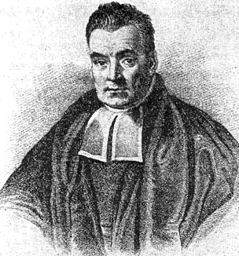
Time for a trick! Bayes rule, named after Thomas Bayes, 1700's.

Slide 7
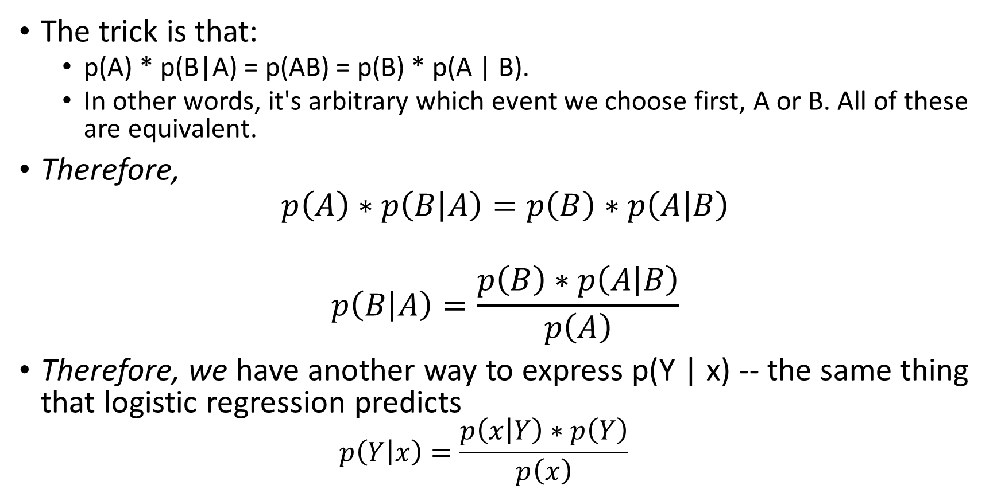
Time for a trick! Bayes rule, named after Thomas Bayes, 1700's.
The trick is that:
p(A) * p(B|A) = p(AB) = p(B) * p(A | B).
In other words, it's arbitrary which event we choose first, A or B. All of these are equivalent.
Therefore,
$$p\left(A\right)∗p\left(B | A\right)=p\left(B\right)∗p\left(A | B\right)$$
$$p\left(B | A\right)=\frac{p\left(B\right)∗p\left(A | B\right)}{p\left(A\right)}$$
Therefore, we have another way to express p(Y | x) -- the same thing that logistic regression predicts
$$p\left(Y | x\right)=\frac{p\left(x | Y\right)∗p\left(Y\right)}{p\left(x\right)}$$
IT'S BEAUTIFUL

Slide 8
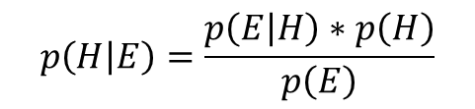
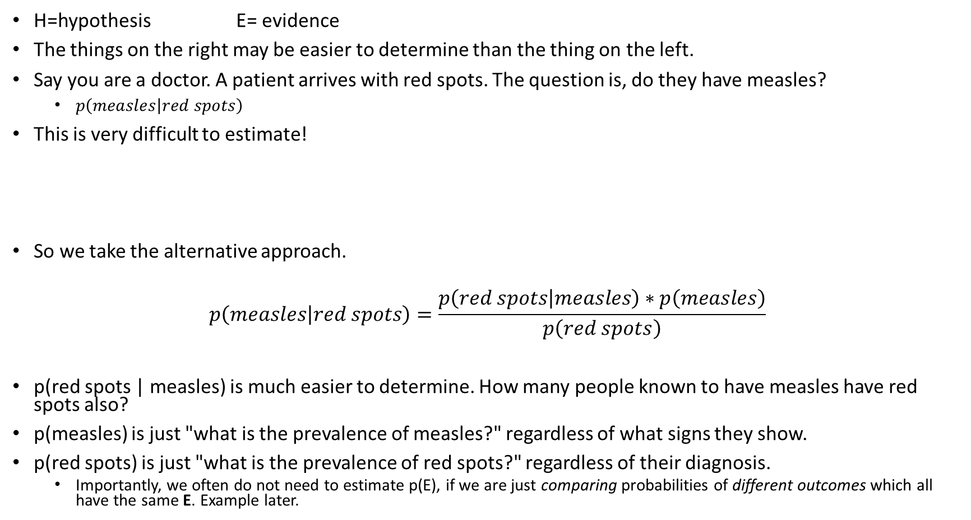
So how do we use it, and why?
$$p\left(H | E\right)=\frac{p\left(E | H\right)∗p\left(H\right)}{p\left(E\right)}$$
H=hypothesis E= evidence
The things on the right may be easier to determine than the thing on the left.
Say you are a doctor. A patient arrives with red spots. The question is, do they have measles?
$p\left(measles | red spots\right)$
This is very difficult to estimate!
So we take the alternative approach.
$$p\left(measles | red spots\right)=\frac{p\left(red spots | measles\right)∗p\left(measles\right)}{p\left(red spots\right)}$$
p(red spots | measles) is much easier to determine. How many people known to have measles have red spots also?
p(measles) is just "what is the prevalence of measles?" regardless of what signs they show.
p(red spots) is just "what is the prevalence of red spots?" regardless of their diagnosis.
Importantly, we often do not need to estimate p(E), if we are just comparing probabilities of different outcomes which all have the same E. Example later.
“In order to directly estimate p( measles | red spots) we would need to think through all the different reasons a person might exhibit red spots and what proportion of them would be measles. This is likely impossible even for the most broadly knowledgeable physician.”

Slide 9
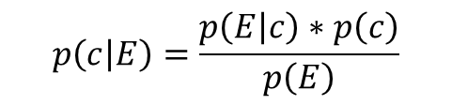
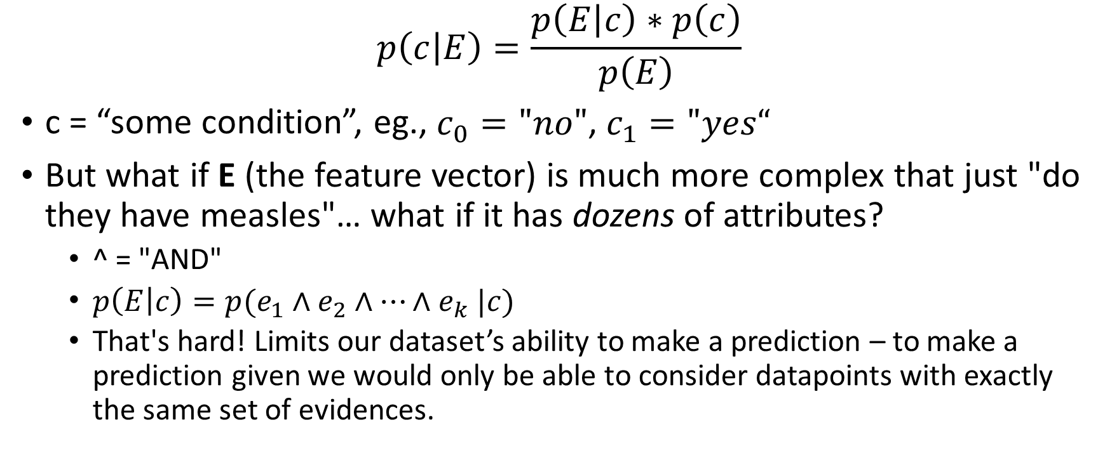
In machine learning language…
$$p\left(c | E\right)=\frac{p\left(E | c\right)∗p\left(c\right)}{p\left(E\right)}$$
$$p\left(c | E\right)=\frac{p\left(E | c\right)∗p\left(c\right)}{p\left(E\right)}$$
c = “some condition”, eg., $c_{0}="no"$, $c_{1}="yes“$
But what if E (the feature vector) is much more complex that just "do they have measles"… what if it has dozens of attributes?
^ = "AND"
$p\left(E | c\right)=p(e_{1}∧e_{2}∧…{∧e}_{k}|c)$
That's hard! Limits our dataset’s ability to make a prediction – to make a prediction given we would only be able to consider datapoints with exactly the same set of evidences.
Like… runny nose, fever, red spots, cranky…

Slide 10
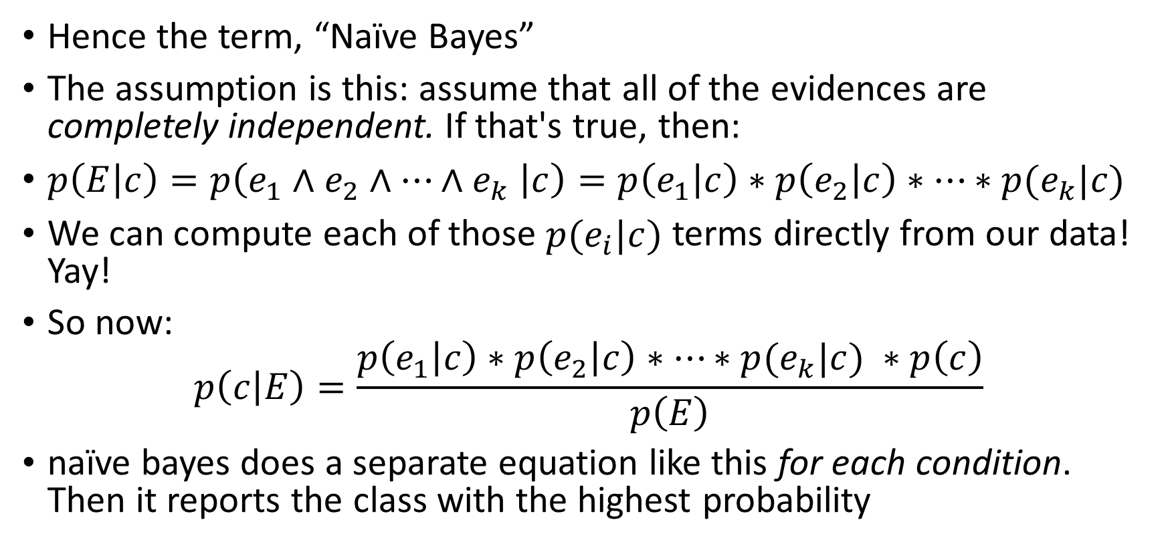
To deal with this problem, let’s make a naïve assumption
That’s the joke
Hence the term, “Naïve Bayes”
The assumption is this: assume that all of the evidences are completely independent. If that's true, then:
$p\left(E | c\right)=p\left(e_{1}∧e_{2}∧…{∧e}_{k} | c\right)=p\left(e_{1} | c\right)∗p\left(e_{2} | c\right)∗…∗p(e_{k}|c)$
We can compute each of those $p(e_{i}|c)$ terms directly from our data! Yay!
So now:
$$p\left(c | E\right)=\frac{p\left(e_{1} | c\right)∗p\left(e_{2} | c\right)∗…∗p(e_{k}|c) ∗p\left(c\right)}{p\left(E\right)}$$
naïve bayes does a separate equation like this for each condition. Then it reports the class with the highest probability

Slide 11
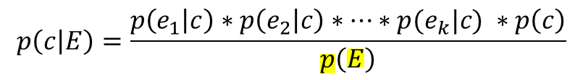
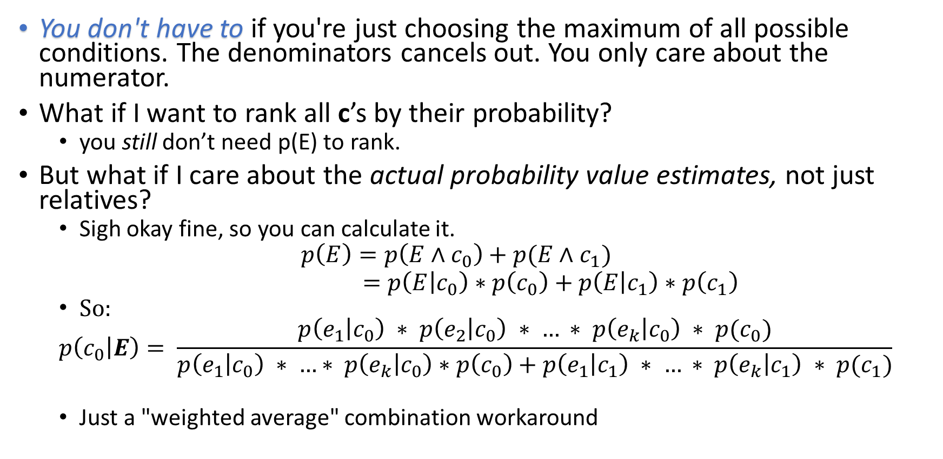
Wait, how do we compute p(E)?
$$p\left(c | E\right)=\frac{p\left(e_{1} | c\right)∗p\left(e_{2} | c\right)∗…∗p(e_{k}|c) ∗p\left(c\right)}{p\left(E\right)}$$
You don't have to if you're just choosing the maximum of all possible conditions. The denominators cancels out. You only care about the numerator.
What if I want to rank all c’s by their probability?
you still don’t need p(E) to rank.
But what if I care about the actual probability value estimates, not just relatives?
Sigh okay fine, so you can calculate it.
$$p\left(E\right)=p\left(E∧c_{0}\right)+p(E∧c_{1})$$
$=p\left(E | c_{0}\right)∗p\left(c_{0}\right)+p\left(E | c_{1}\right)∗p\left(c_{1}\right)$
So:
$$p\left(c_{0} | E\right)= \frac{p\left(e_{1} | c_{0}\right) ∗ p\left(e_{2} | c_{0}\right) ∗ … ∗ p\left(e_{k} | c_{0}\right) ∗ p(c_{0})}{p\left(e_{1} | c_{0}\right) ∗ …∗ p\left(e_{k} | c_{0}\right)∗p\left(c_{0}\right)+p\left(e_{1} | c_{1}\right) ∗ … ∗ p\left(e_{k} | c_{1}\right) ∗ p(c_{1})}$$
Just a "weighted average" combination workaround

Slide 12
Advantages and Disadvantages of Naïve Bayes
Very simple classifier
Efficient in terms of both storage space and computation time
Performs surprisingly well in many real-world applications
Non-accurate class probability estimation
Incremental learner
Normally, takes time to crunch data and produce models… think about how slow DataRobot is.
No algorithm to re-run for naïve bayes! Just counting and probabilities!
Example of "Junk" email updating the model immediately for each new classification. You don't have to go back and re-induce the model from the entire training data again. You just increment your counts and re-do probability estimations, done. It's fast.

Slide 13
Evidence Lift
How much does one feature increase or decrease the probability of some outcome?

Slide 14
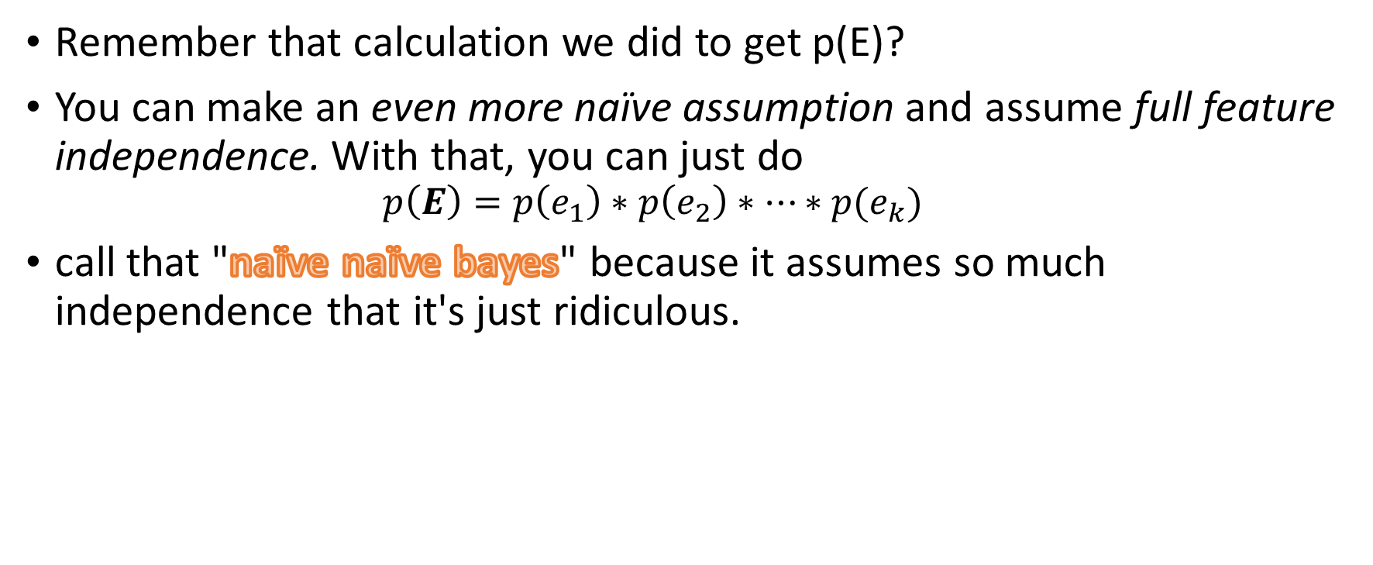
Assumption of full feature independence:
Remember that calculation we did to get p(E)?
You can make an even more naïve assumption and assume full feature independence. With that, you can just do
$$p\left(E\right)=p\left(e_{1}\right)∗p\left(e_{2}\right)∗…∗p(e_{k})$$
call that "naïve naïve bayes" because it assumes so much independence that it's just ridiculous.
That’s the double-joke

Slide 15
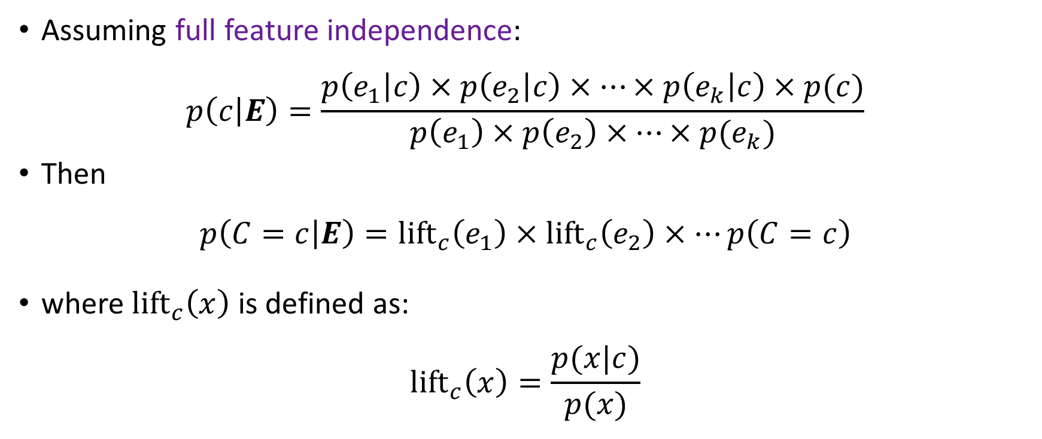
A Model of Evidence “Lift”
Assuming full feature independence:
$$p\left(c | E\right)=\frac{p\left(e_{1} | c\right)×p\left(e_{2} | c\right)×…×p\left(e_{k} | c\right)×p(c)}{p\left(e_{1}\right)×p\left(e_{2}\right)×…×p(e_{k})}$$
Then
$$p\left(C=c | E\right)=\text{lif}{\text{t}}_{c}\left(e_{1}\right)×\text{lif}{\text{t}}_{c}\left(e_{2}\right)×…p\left(C=c\right)$$
where $\text{lif}{\text{t}}_{c}\left(x\right)$ is defined as:
$$\text{lif}{\text{t}}_{c}\left(x\right)=\frac{p(x|c)}{p(x)}$$

Slide 16
Hotel Example
How does web browsing behavior predict probability of booking?
Overall probability of booking is 0.0001.
Visited a finance website? Multiply the probability of booking by a factor of two.
Visit a truck-pull site? Multiply the probability by a factor of 0.25.
And so on.
Warning -- because we assume complete independence, the individual estimates of lift do not account for the presence of others with which they may be correlated. Therefore, because the correlation is not accounted for, the lifts may be higher or lower than they would otherwise be. This leads to the lifts being inflated.
So lifts are useful for comparison, but when they're all combined together, the final probability score is not accurate as an actual measure of absolute probability. It will be distorted.
Do not rely on naïve bayes for objective ground truth – only for relative impact

Slide 17
Example: Evidence Lifts from Facebook “Likes”
What people “Like” on Facebook is quite predictive of:
How they score on intelligence tests
How they score on psychometric tests (e.g., how extroverted or conscientious they are)
Whether they drink alcohol or smoke
Their religion and political views
…
Here’s some data predicting “How does what someone “like” impact the likelihood of them having High IQ?”

Slide 18
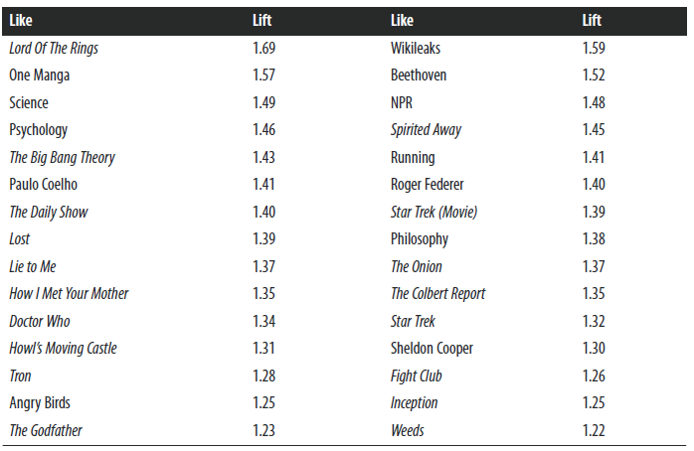
Example: Evidence Lifts from Facebook “Likes”

Slide 19
Workbook for lab, lab to be posted soon
Search canvas files for “NB-example-fill-in.xlsx”

Slide 20
Examples from
Provost, Foster; Fawcett, Tom. Data Science for Business: What You Need to Know about Data Mining and Data-Analytic Thinking (Kindle Locations 5356-5358). O'Reilly Media. Kindle Edition.

Slide 21
Many figures in this slide deck from Provost, F., & Fawcett, T. (2013). Data science for business: what you need to know about data mining and data-analytic thinking. Sebastopol, Calif.: O'Reilly.

